Slide 1
Project Title
IoT Automatic Control System Based on User Command Analysis

Slide 2
CONTENT
A. Relevance of topic
B.A Description of the Project
C. Objectives of the Study
D. Existing System and Proposed System
E.Screenshots

Slide 3
Relevance of topic
The data generated by objects and people included in the IoT network is increasing exponentially, and there are requirements to be solved by IoT systems such as real-time processing capability and accurate semantic information.
Existing IoT systems are transmit data measured through a sensor to a server, load it in a database, and extract and provide data according to the user's request. Such a system operates the device through a threshold value in the server, but does not consider the characteristics of the user, and thus the device operates even when the user does not want it .
In order to solve this problem, This project, when the user remotely controls the device, the command is collected and the existing threshold value and analysis are performed to set the threshold value suitable for the user. Also, threshold are loaded into the database and provided to the user application.

Slide 4

A Description of the Project
The system collects the user's remote control commands to organize and classify the user's work orders in time to derive the average operation of the devices. Through this, it is possible to provide services with improved user convenience and system accuracy.

Slide 5

Objectives of the Study
House Climate Control is Easier than Ever
Smart Furniture Increases Productivity
A Smart Office Cuts Down on Energy Consumption

Slide 6
Existing System and Proposed System

Slide 7
Existing System
Existing IoT systems provide services such as environment control and repeating operation. As the work progresses automatically, there is a problem with accuracy. Accordingly, the user should be able to receive the service at a desired time. Also, it is required to provide a user oriented service by changing the system according to the user.

Slide 8
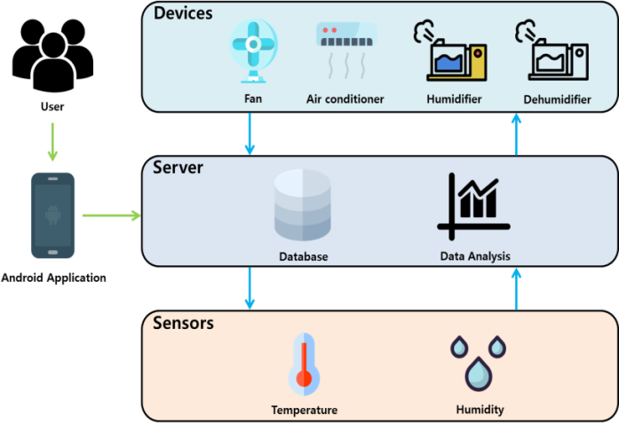
Proposed System
The proposed system collects user 's remote control command and analyzes it, so that the service can be provided based on the user' s record.
The user uses the Android application to transmit the remote control command to the server. The server controls the device according to the command, collects the corresponding commands, analyzes the information, and visualizes the amount of usage of the smart device by the user

Slide 9
DATASET
The device usage rate by time

Slide 10
System Design

Slide 11
add your words here
This Figure shows the configuration of the proposed IoT automatic control system based on user command analysis.

Slide 12
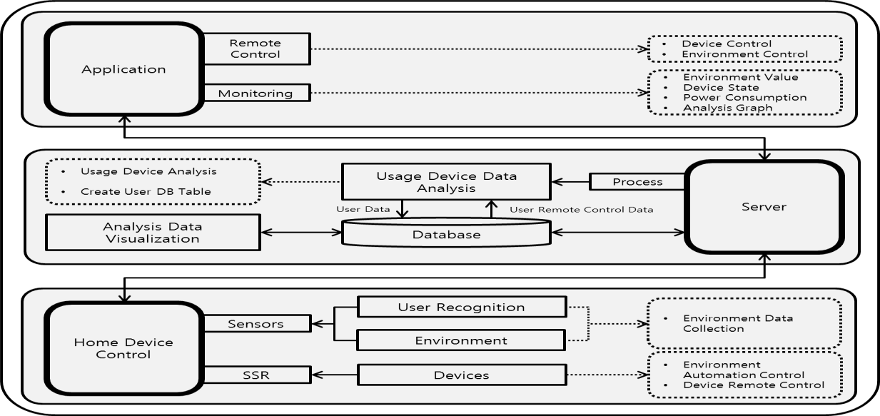
Automation Control System Architecture

Slide 13
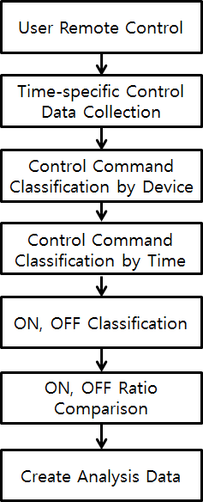
User Command Analysis Algorithm

Slide 14
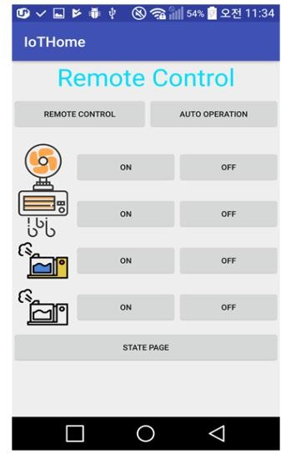
SYSTEM IMPLEMENTATION
The proposed system utilizes the application to collect user commands and monitor the status of the device. It can also provide the user with visualized information or change the operating mode. The user can change the status of the device by using the remote control function and can check the status of the devices by utilizing the monitoring function. You can also check the data measured by sensors in the home and check the usage of the devices in a graph.

Slide 15
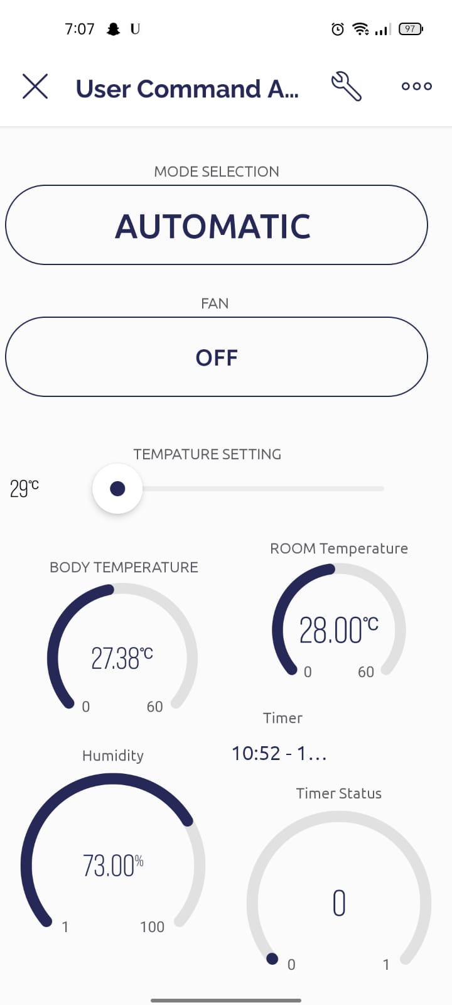
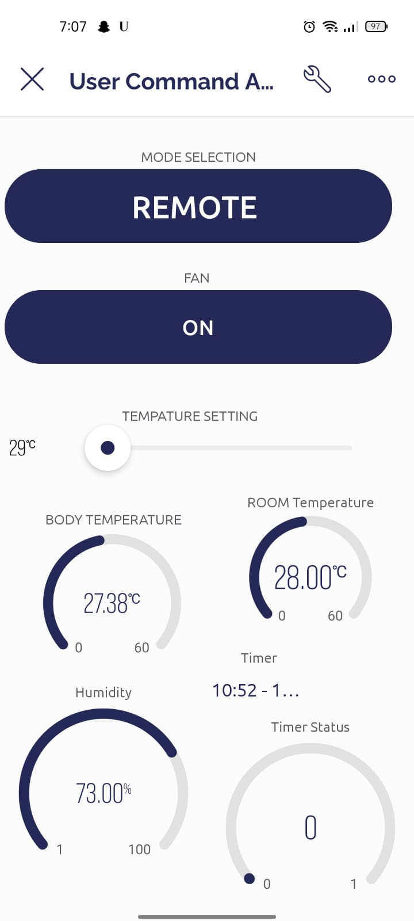
SCREENSHOTS

Slide 16
THANKS

